Slide 1
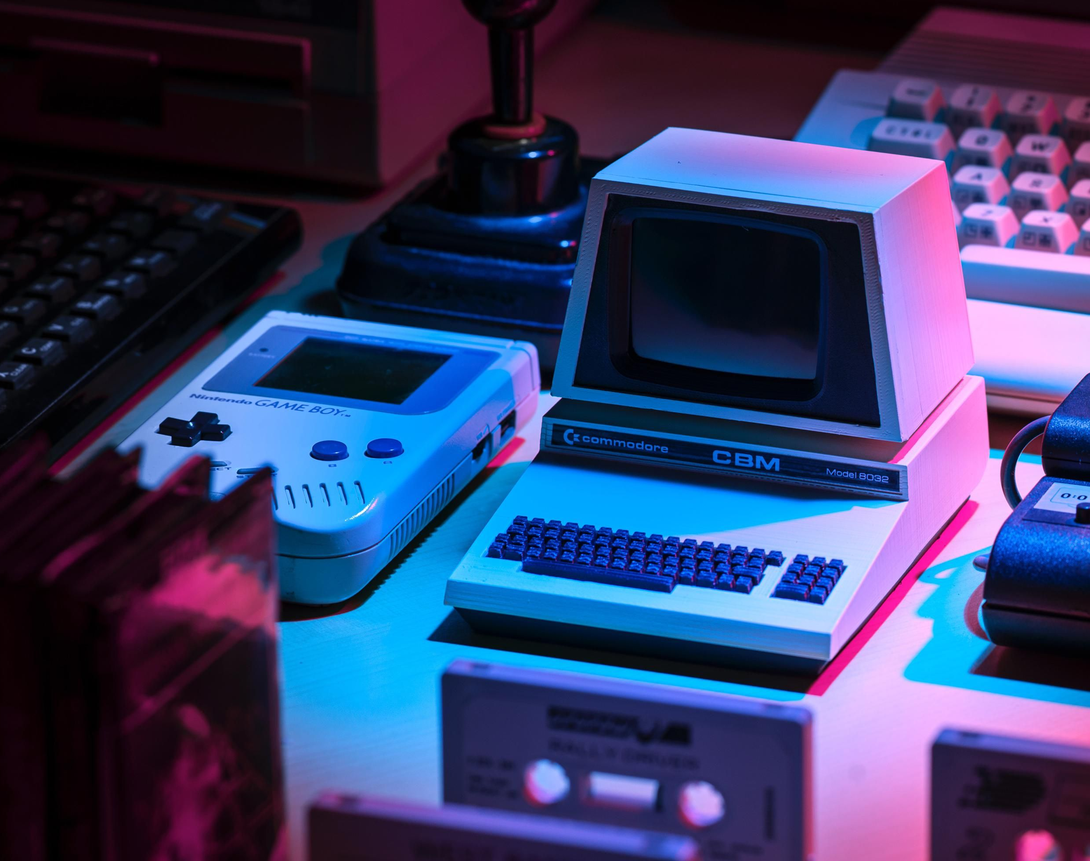
Game Development Life Cycle
Azim Pathan
CIS 3060 – System Analysis and Design

Slide 2
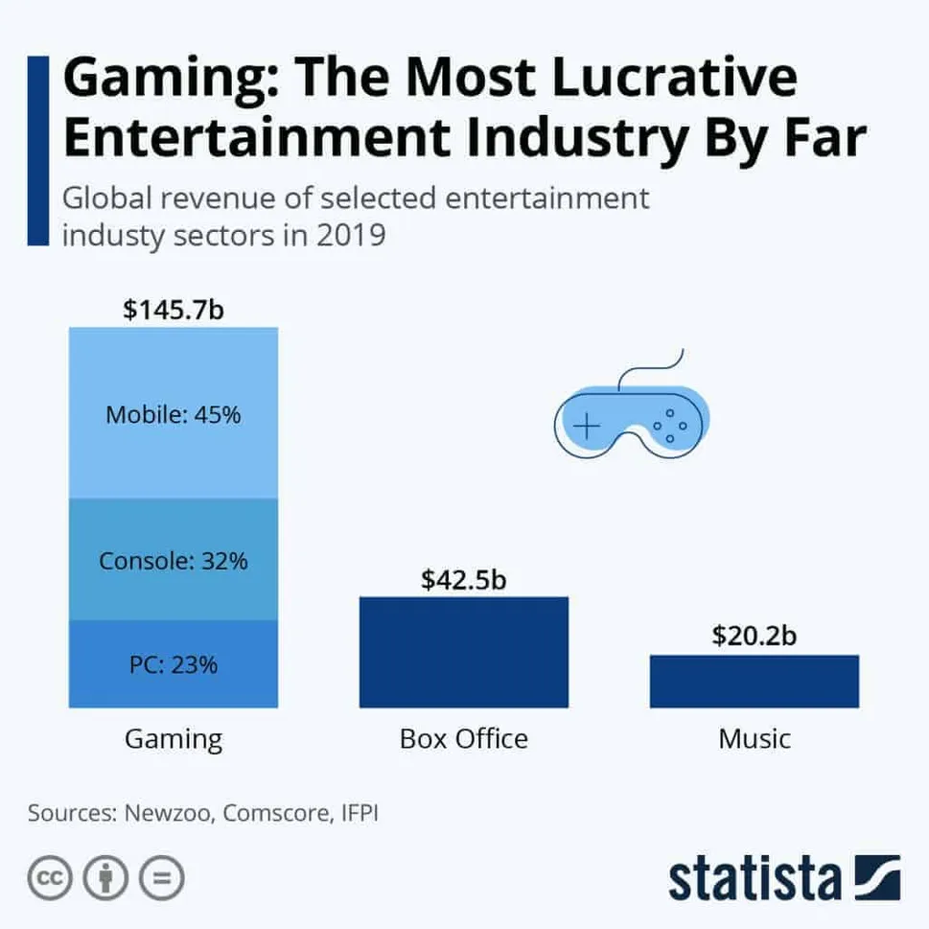
Video Game Industry Revenue
Gaming Industry
Film Industry
Sports Industry
“The COVID-19 pandemic has propelled the [gaming] industry to make more money than movies and North American sports combined.” (Market Watch)

Slide 3

Why is the Game Development Life Cycle Important?
Huge Market Potential
Complex Design Process
Decreases Risks
Increases Speed of Development
Improves Project Management
Reduces Management Expenses

Slide 4
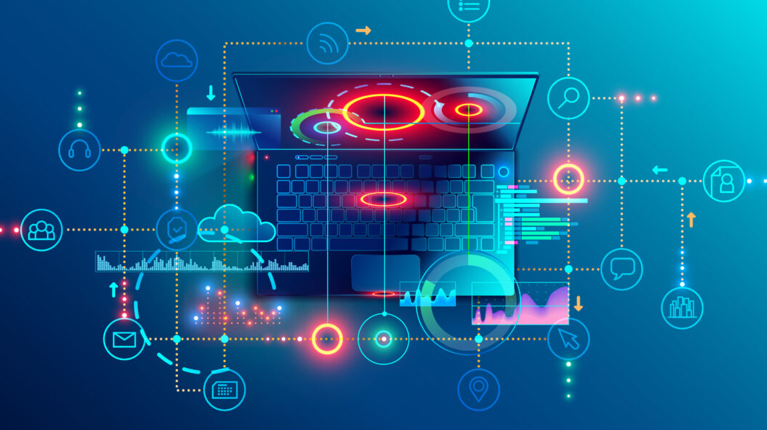
Game Development Life Cycle Phases
1. Planning – Idea, Budget, Platform, Audience
2. Technical Requirement Analysis – Functional vs. Non-Functional
4. Testing – Test Cases, Identifying Bugs
5. Pre-Launch – Marketing, Implementing Feedback
6. Deployment – Polishing and Game Launch
7. Maintenance – Patching Lingering Issues, Maintaining Servers, and Development of DLC
3. Development – Programming and Implementation of Requirements

Slide 5

1. Planning Phase
Idea/Concept
Audience (Horizontal/Vertical)
Budget/Monetization
Scope
Platform
Timeframe
Notes:
Idea/Concept: What kind of game should we create?
Audience: Who is our target audience?
Budget: How much will it cost? How will it be monetized?
Scope: How big is the project? Who do we need to hire?
Platform: What platform will it be on? (Mobile/PC/Console)
Timeframe: How long will it take?

Slide 6
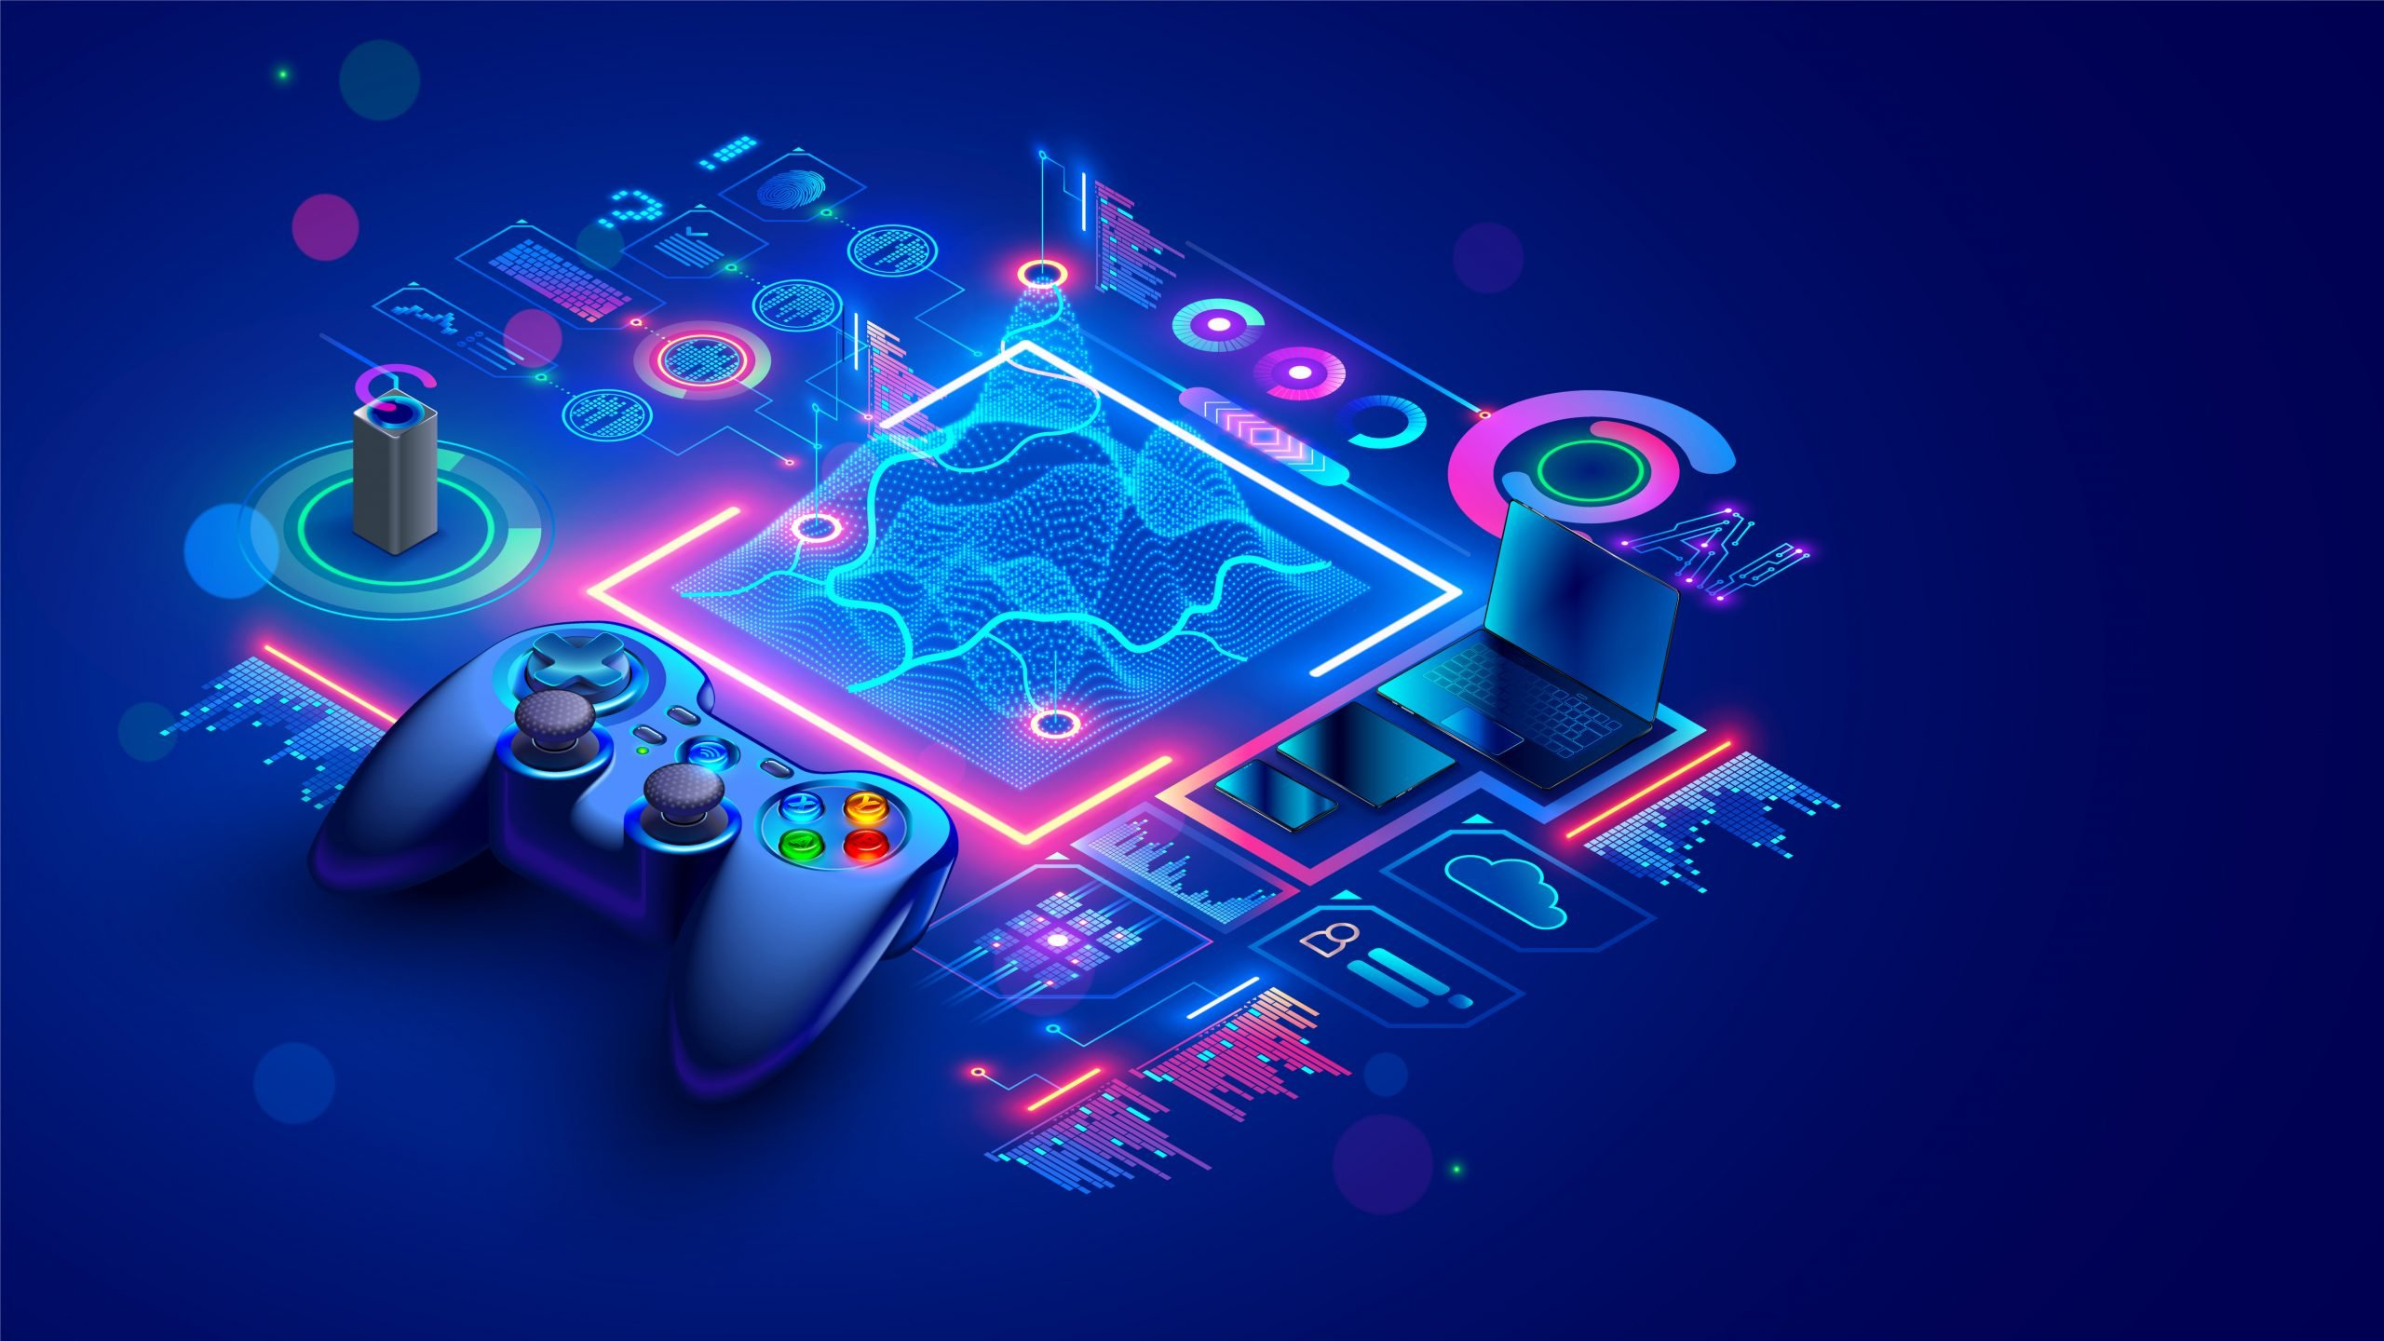
2. Technical Requirement Analysis Phase
What are the Functional and Non-Functional Requirements?

Slide 7
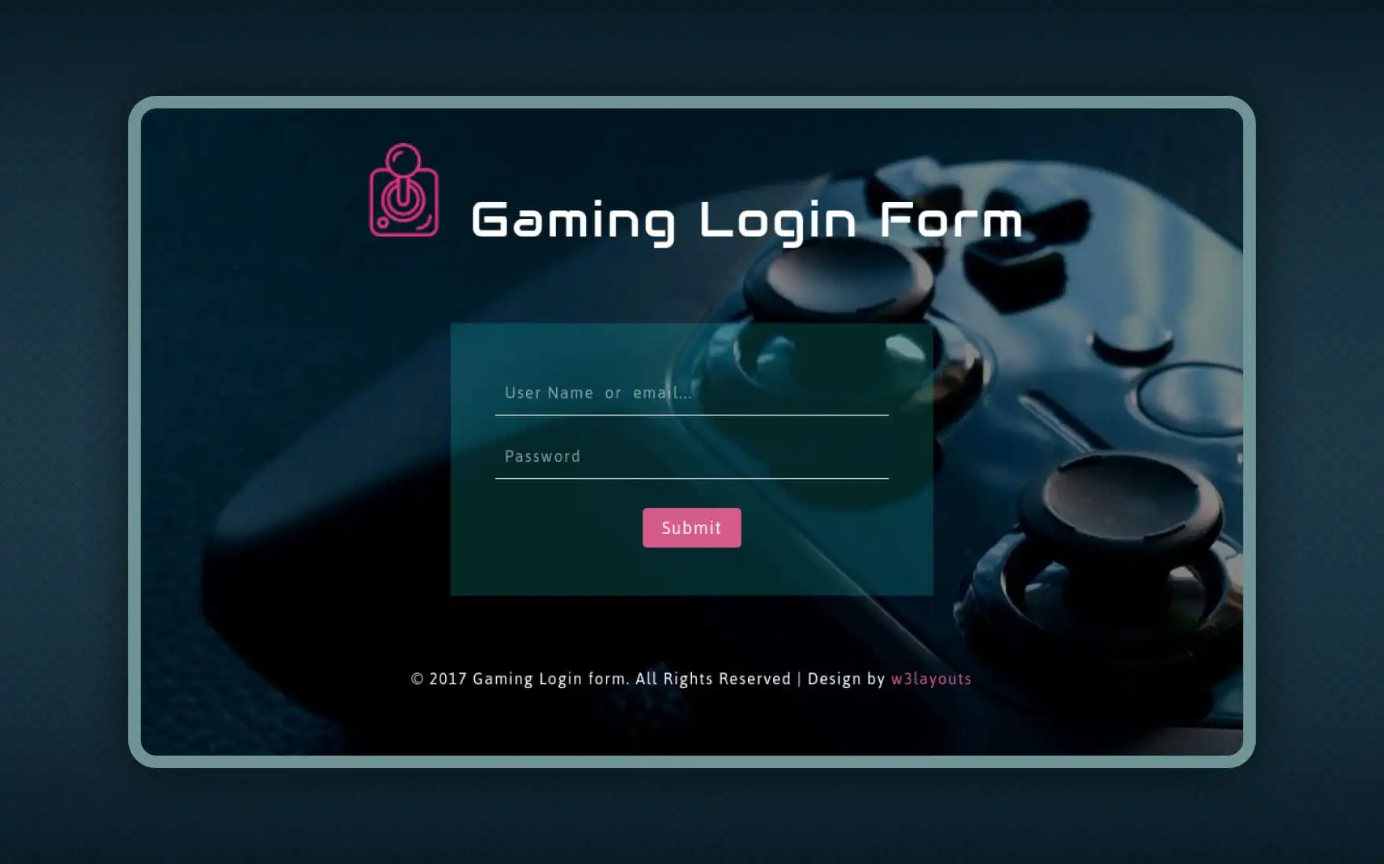
2a. Functional Requirements
Player Login
Create a Character
Connect With Other Players
Join a Match
Battle Monsters
Check Records and Statistics
Music, Graphics, etc.

Slide 8
2b. Non-Functional Requirements
Performance
Scalability
Reliability
Security
Recoverability
Maintainability

Slide 9

3. Development Phase
User Interface
Audio Design/Music Production
Visual/Graphical Effects
Physics Engine
Servers/Database Infrastructure
Notes:
Lead Programmer creates a checklist for Technical Requirements
Audio also includes voice acting and sfx to make the game more immersive
Development scope is completely dependent on the requirements.

Slide 10

4. Play Testing/Debugging Phase
Extremely Crucial Stage
Identifying Bugs
Bug Tracking Report and Logging
Is It Fun? Too Easy/Hard?
Design Philosophy Analysis and Review
Notes:
All development bugs must be tracked, logged, and reported.
Are there glitches? Can players exploit systems? Any rendering glitches?
Design flaws?

Slide 11

5. Pre-Launch
Marketing and Advertisements
2nd Debug Phase – Major bug Patches and Polishing
Alpha/Beta Release
& Feedback Gathering
Notes:
Marketing involves, trailers, demos, and other things. Demos allow for interaction and engagement with the product. Announcement of Release Date

Slide 12

6. Deployment
Release Date
More Bug Squashing
Final Game Polishing
Additional Marketing

Slide 13

7. Maintenance and Monitoring
System and Server Maintenance
Identifying Lingering Bugs
Work on Future Digital Content
Provide Customer Support

Slide 14
References
https://ariosoft.com/what-is-the-game-development-life-cycle/
https://www.linkedin.com/pulse/game-development-life-cycle-sumit-jain/
https://jserd.springeropen.com/articles/10.1186/s40411-016-0032-7
https://www.marketwatch.com/story/videogames-are-a-bigger-industry-than-sports-and-movies-combined-thanks-to-the-pandemic-11608654990
https://www.fool.com/investing/2021/10/03/this-opportunity-for-investors-is-bigger-than-movi/
https://raiseyourskillz.com/gaming-industry-vs-other-entertainment-industries-2021/
https://www.synopsys.com/glossary/what-is-sdlc.html
https://www.bitkraft.vc/gaming-industry-market-size/
https://www.betsol.com/blog/7-stages-of-sdlc-how-to-keep-development-teams-running/
https://app.assembla.com/spaces/tank_wars/wiki/Non-Functional_Requirements

